Slide 1
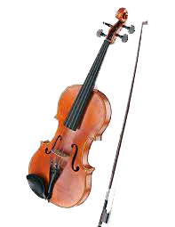
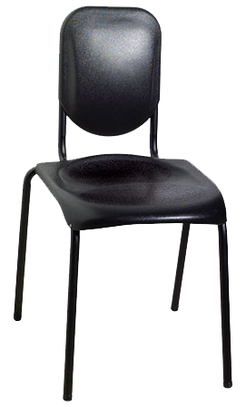
Welcome to the SYMPHONY!

Slide 2
Lesson 1, Activity 1:
Intro to the Orchestra: The Orchestra
What do you know about the orchestra?
What kind of music does an orchestra perform?
Have you ever heard an orchestra?
How many people play in an orchestra?

Slide 4
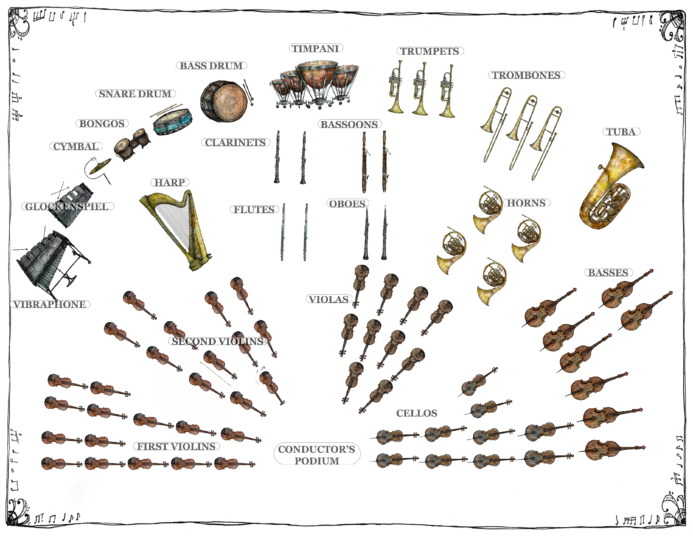
Orchestra Diagram

Slide 5
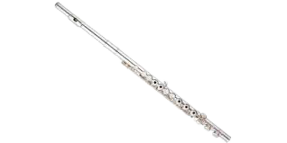
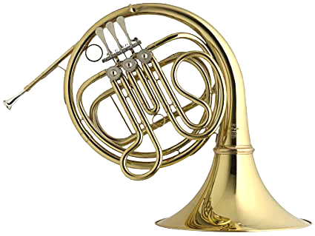
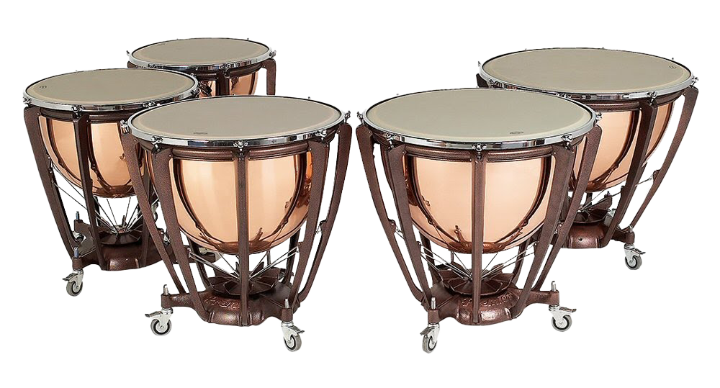
Instrument Families
Percussion
Strings
Woodwinds
Brass

Slide 6
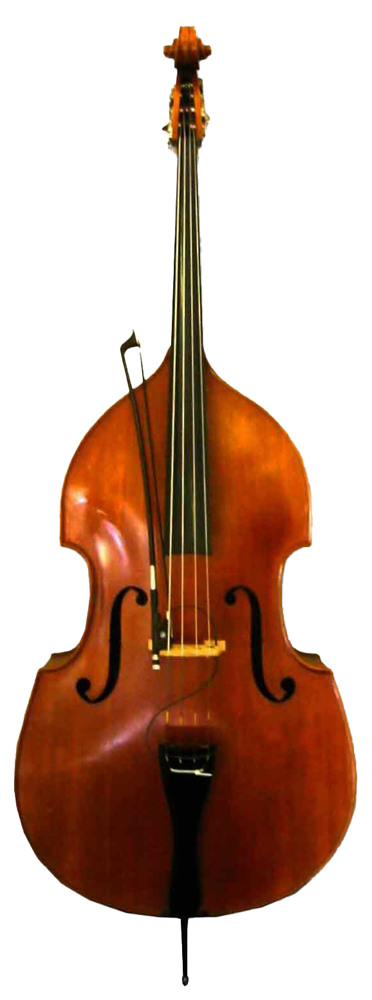
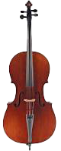
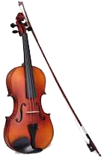
String Family
CELLO
Violin
ViolA
HARP
DOUBLE BASS

Slide 7
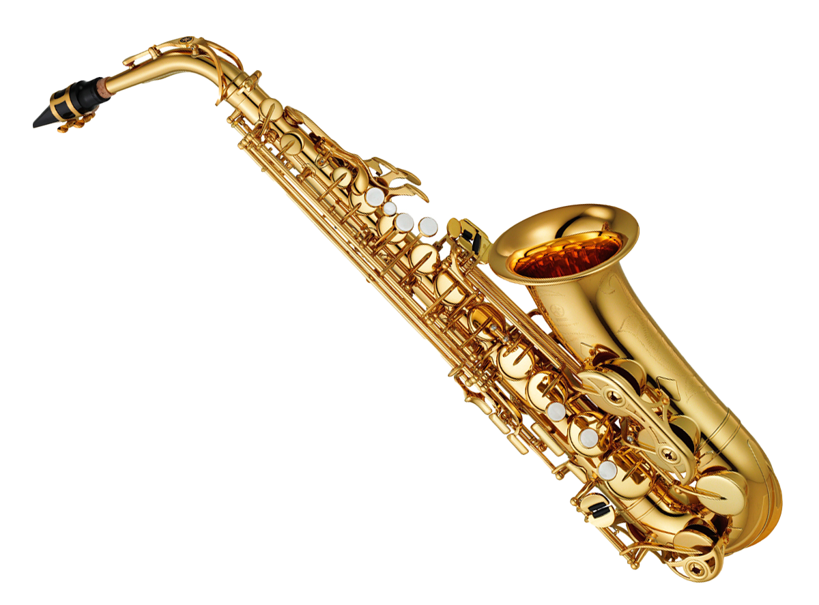
Woodwind Family
flute
oboe
saxophone
clarinet
bassoon

Slide 8
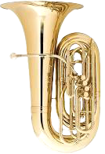
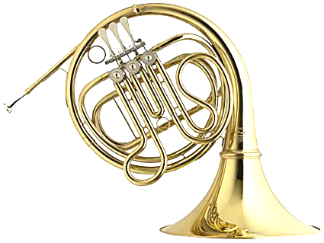
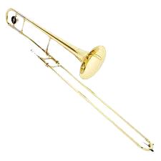
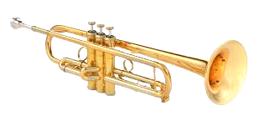
Brass Family
tuba
French horn
trombone
trumpet

Slide 9
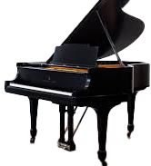
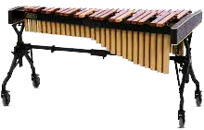
Percussion Family
And many more!!
timpani
piano
xylophone
triangle

Slide 10
Lesson 1, Activity 2:
Intro to the Orchestra: The Conductor
What is a conductor?
What does a conductor do?
What would happen if there was no conductor?
What are some other names for the conductor?

Slide 12
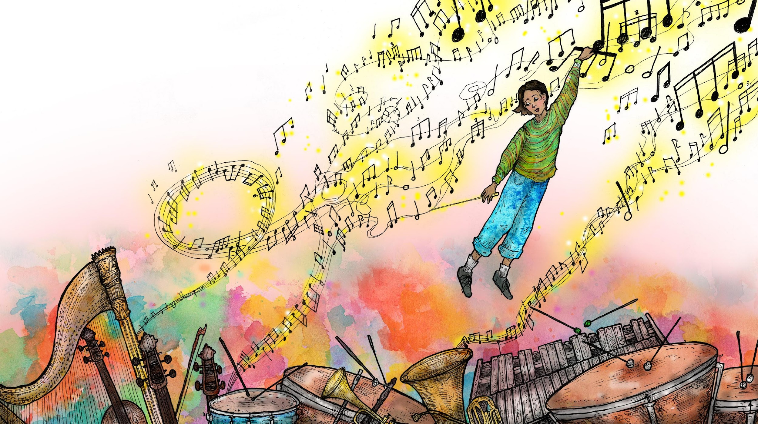
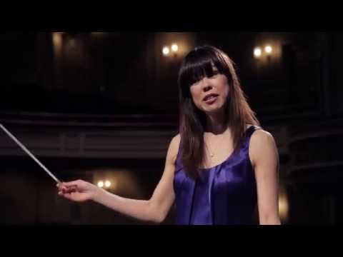
The conductor shows the music’s tempo, and must give very clear instructions to the orchestra so they can make thrilling music together AS ONE!

Slide 13
Use your right hand and follow the conducting pattern: 1, 2, 3, 4 !
You can also think of it as:
DOWN, LEFT, RIGHT, UP!
DOWN, LEFT, RIGHT, UP!
DOWN, LEFT, RIGHT, UP!
DOWN, LEFT, RIGHT, UP!

Slide 14
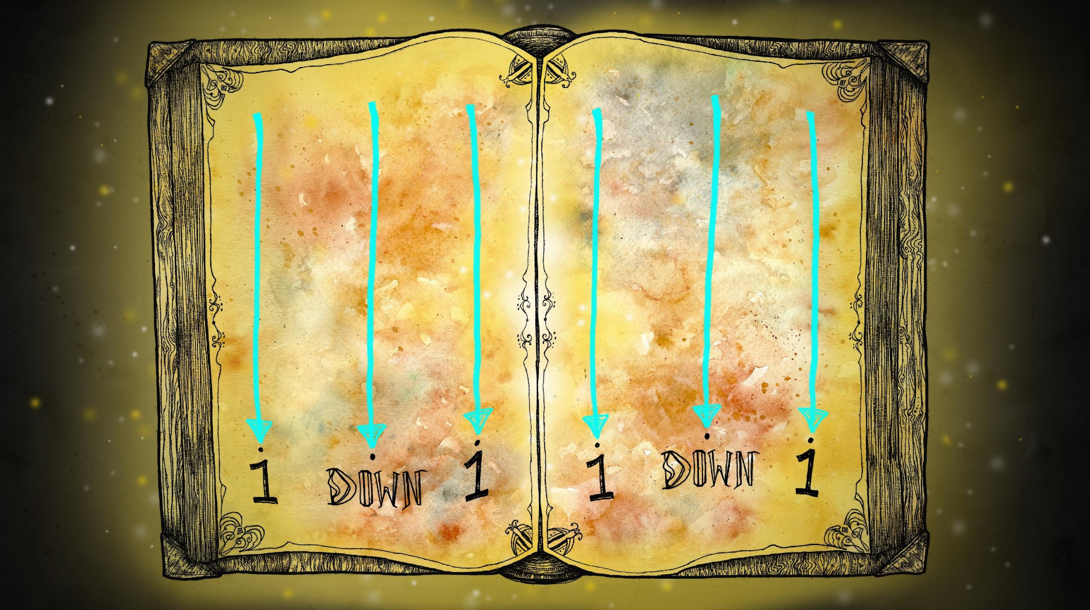
Use your right hand and follow the conducting pattern:
DOWN, DOWN, DOWN!
DOWN, DOWN, DOWN!
DOWN, DOWN, DOWN!
DOWN, DOWN, DOWN!

Slide 15
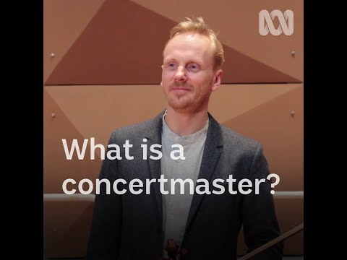
Concertmaster
What is a concertmaster?
What does a concertmaster do?

Slide 17
WHAT IS MUSIC?

Slide 18
WHAT IS MUSIC?
ORGANIZED SOUND!

Slide 19
WHAT IS MUSIC?
WHAT IS SOUND?
ORGANIZED SOUND!

Slide 20
WHAT IS MUSIC?
WHAT IS SOUND?
SOUND IS ANYTHING WE CAN HEAR OR FEEL THROUGH
VIBRATION!
ORGANIZED SOUND!

Slide 21
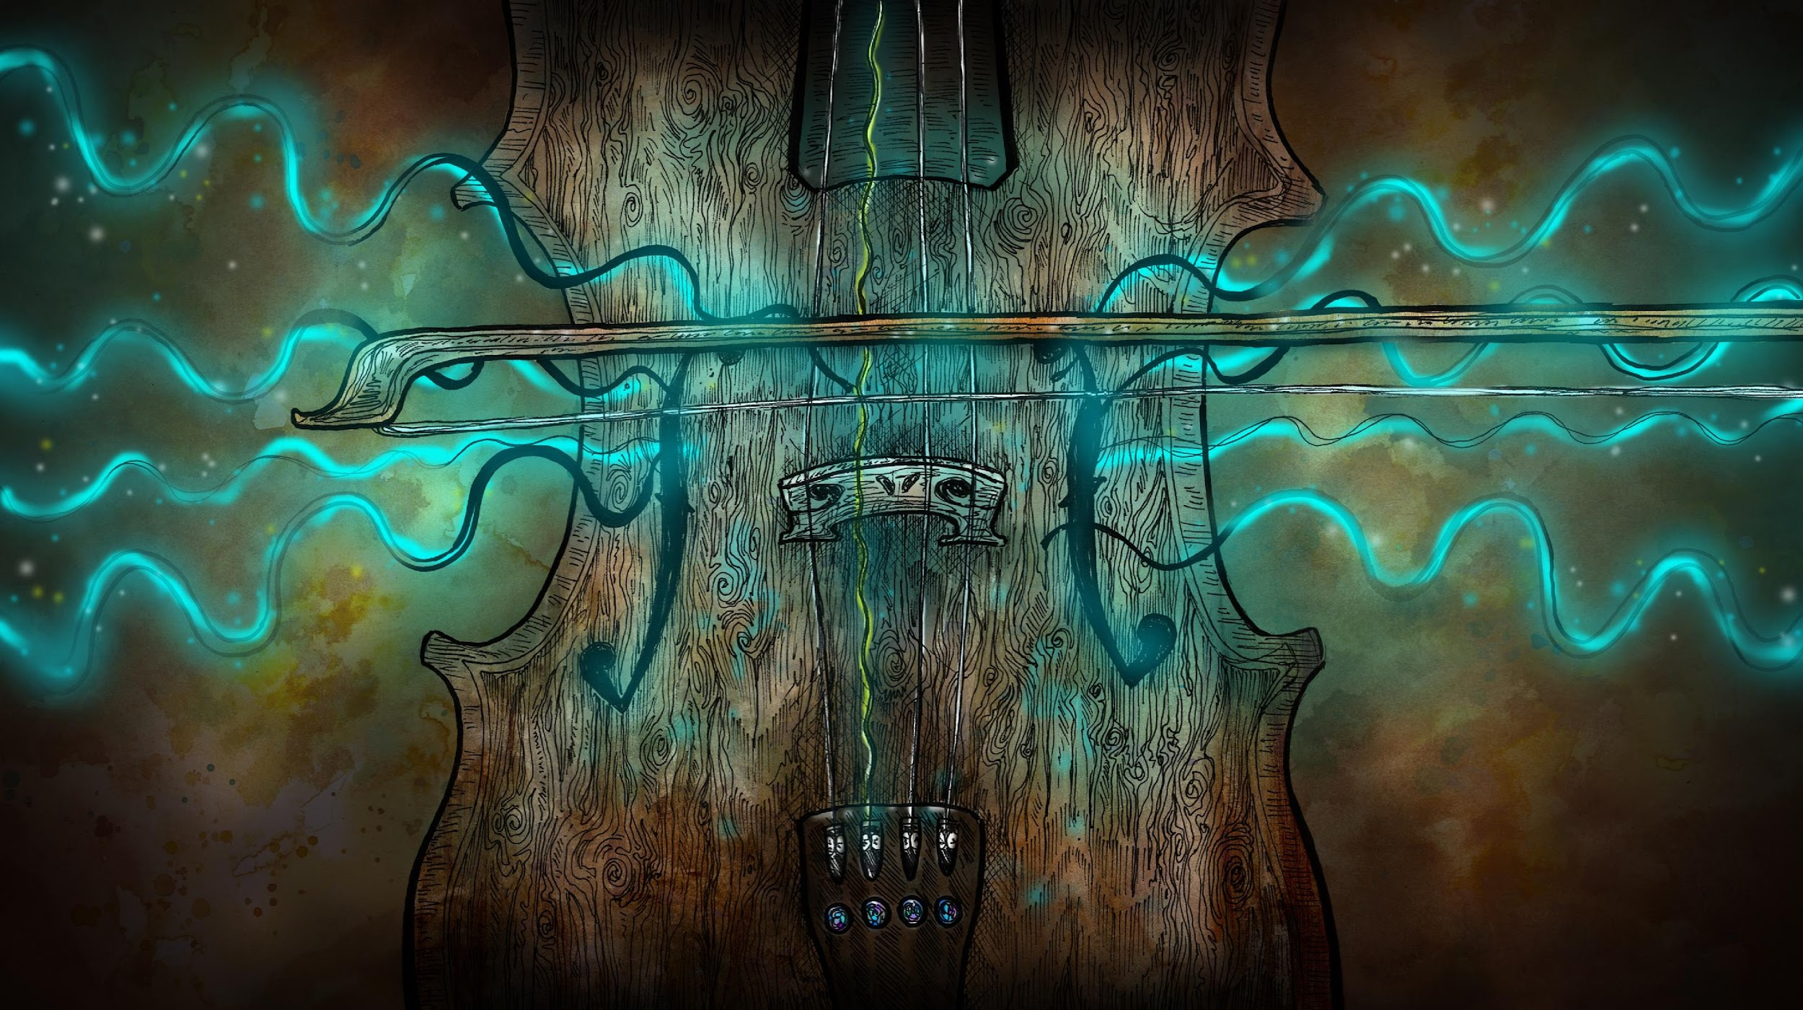
THE VIOLIN PLAYERS PULL THE BOW BACK AND FORTH TO MAKE THE STRINGS VIBRATE!

Slide 22
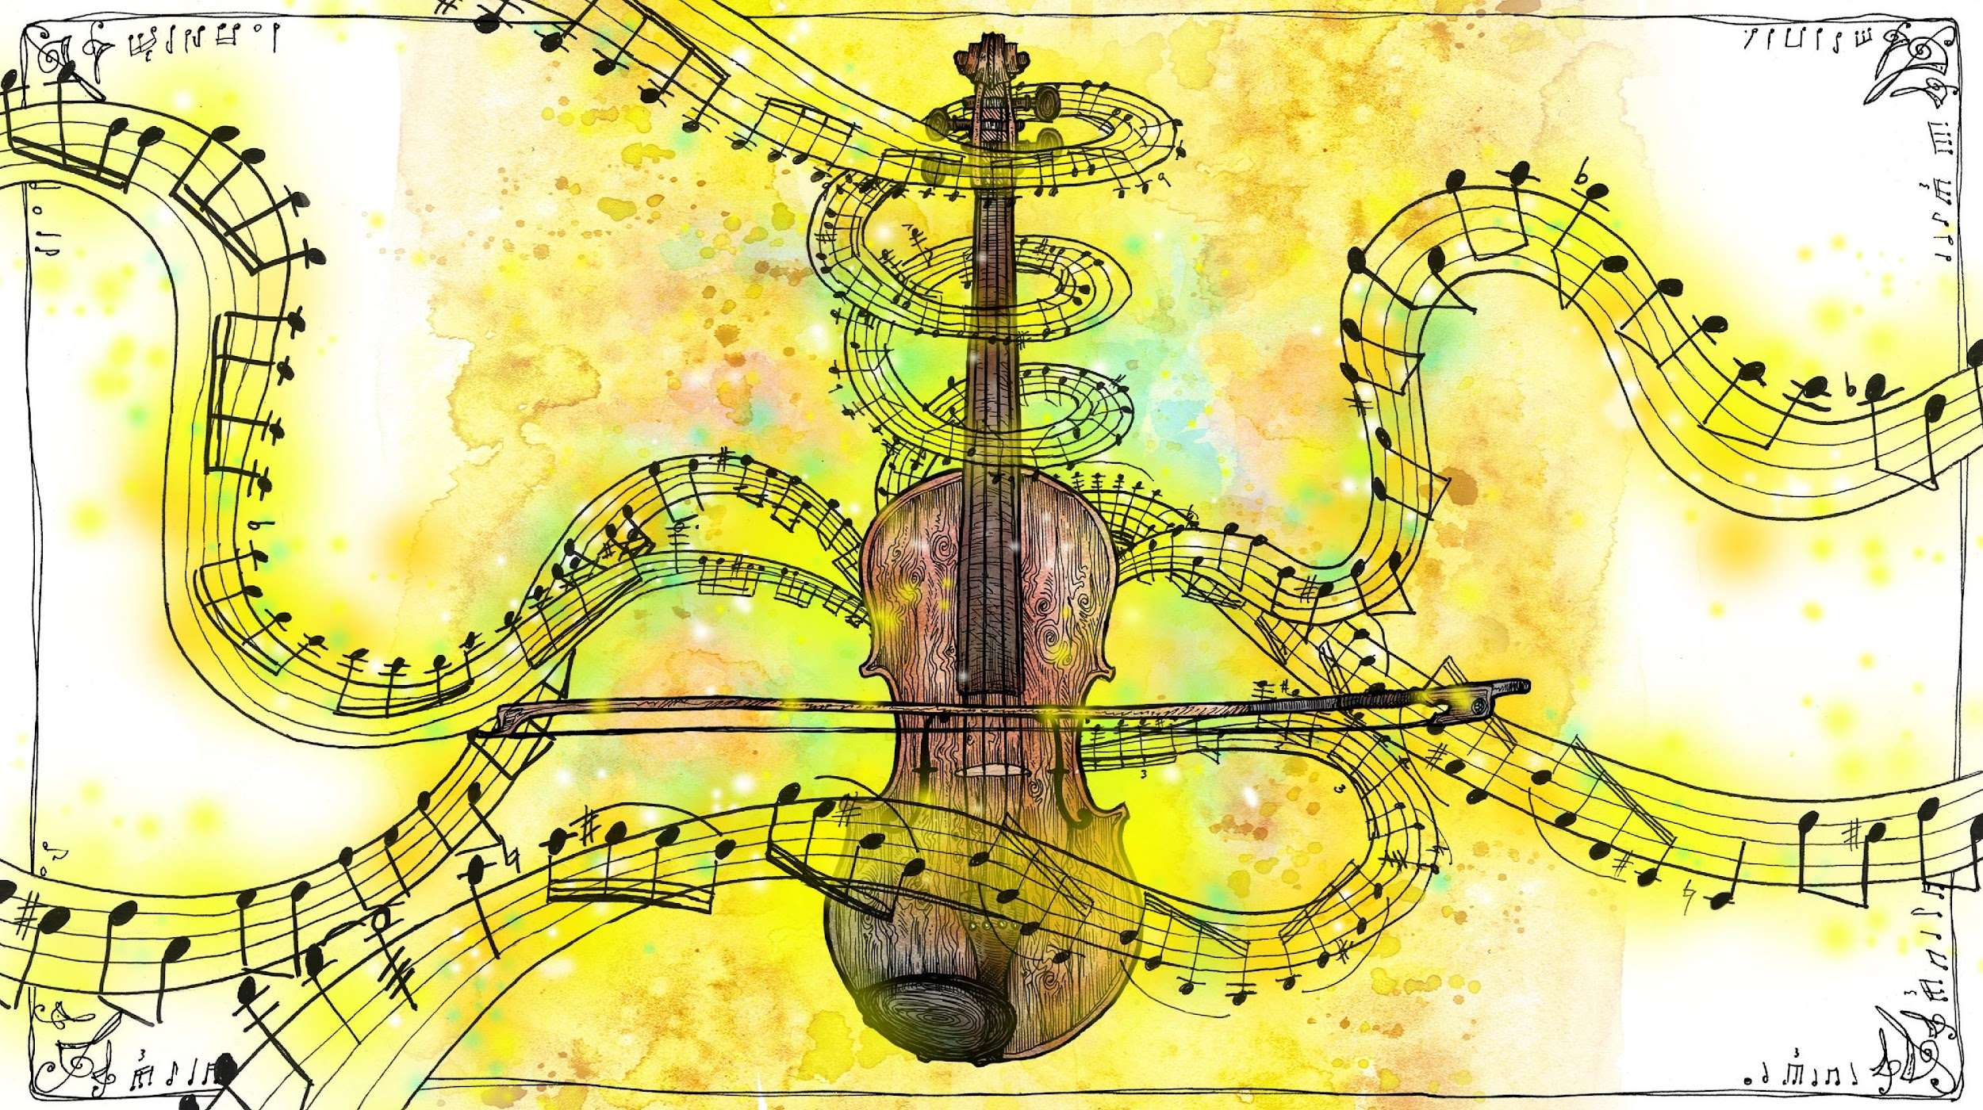
THEY MOVE THEIR FINGERS UP AND DOWN THE LENGTH OF THE STRING TO CHANGE THE VIBRATION AND MAKE BEAUTIFUL MELODIES!

Slide 23
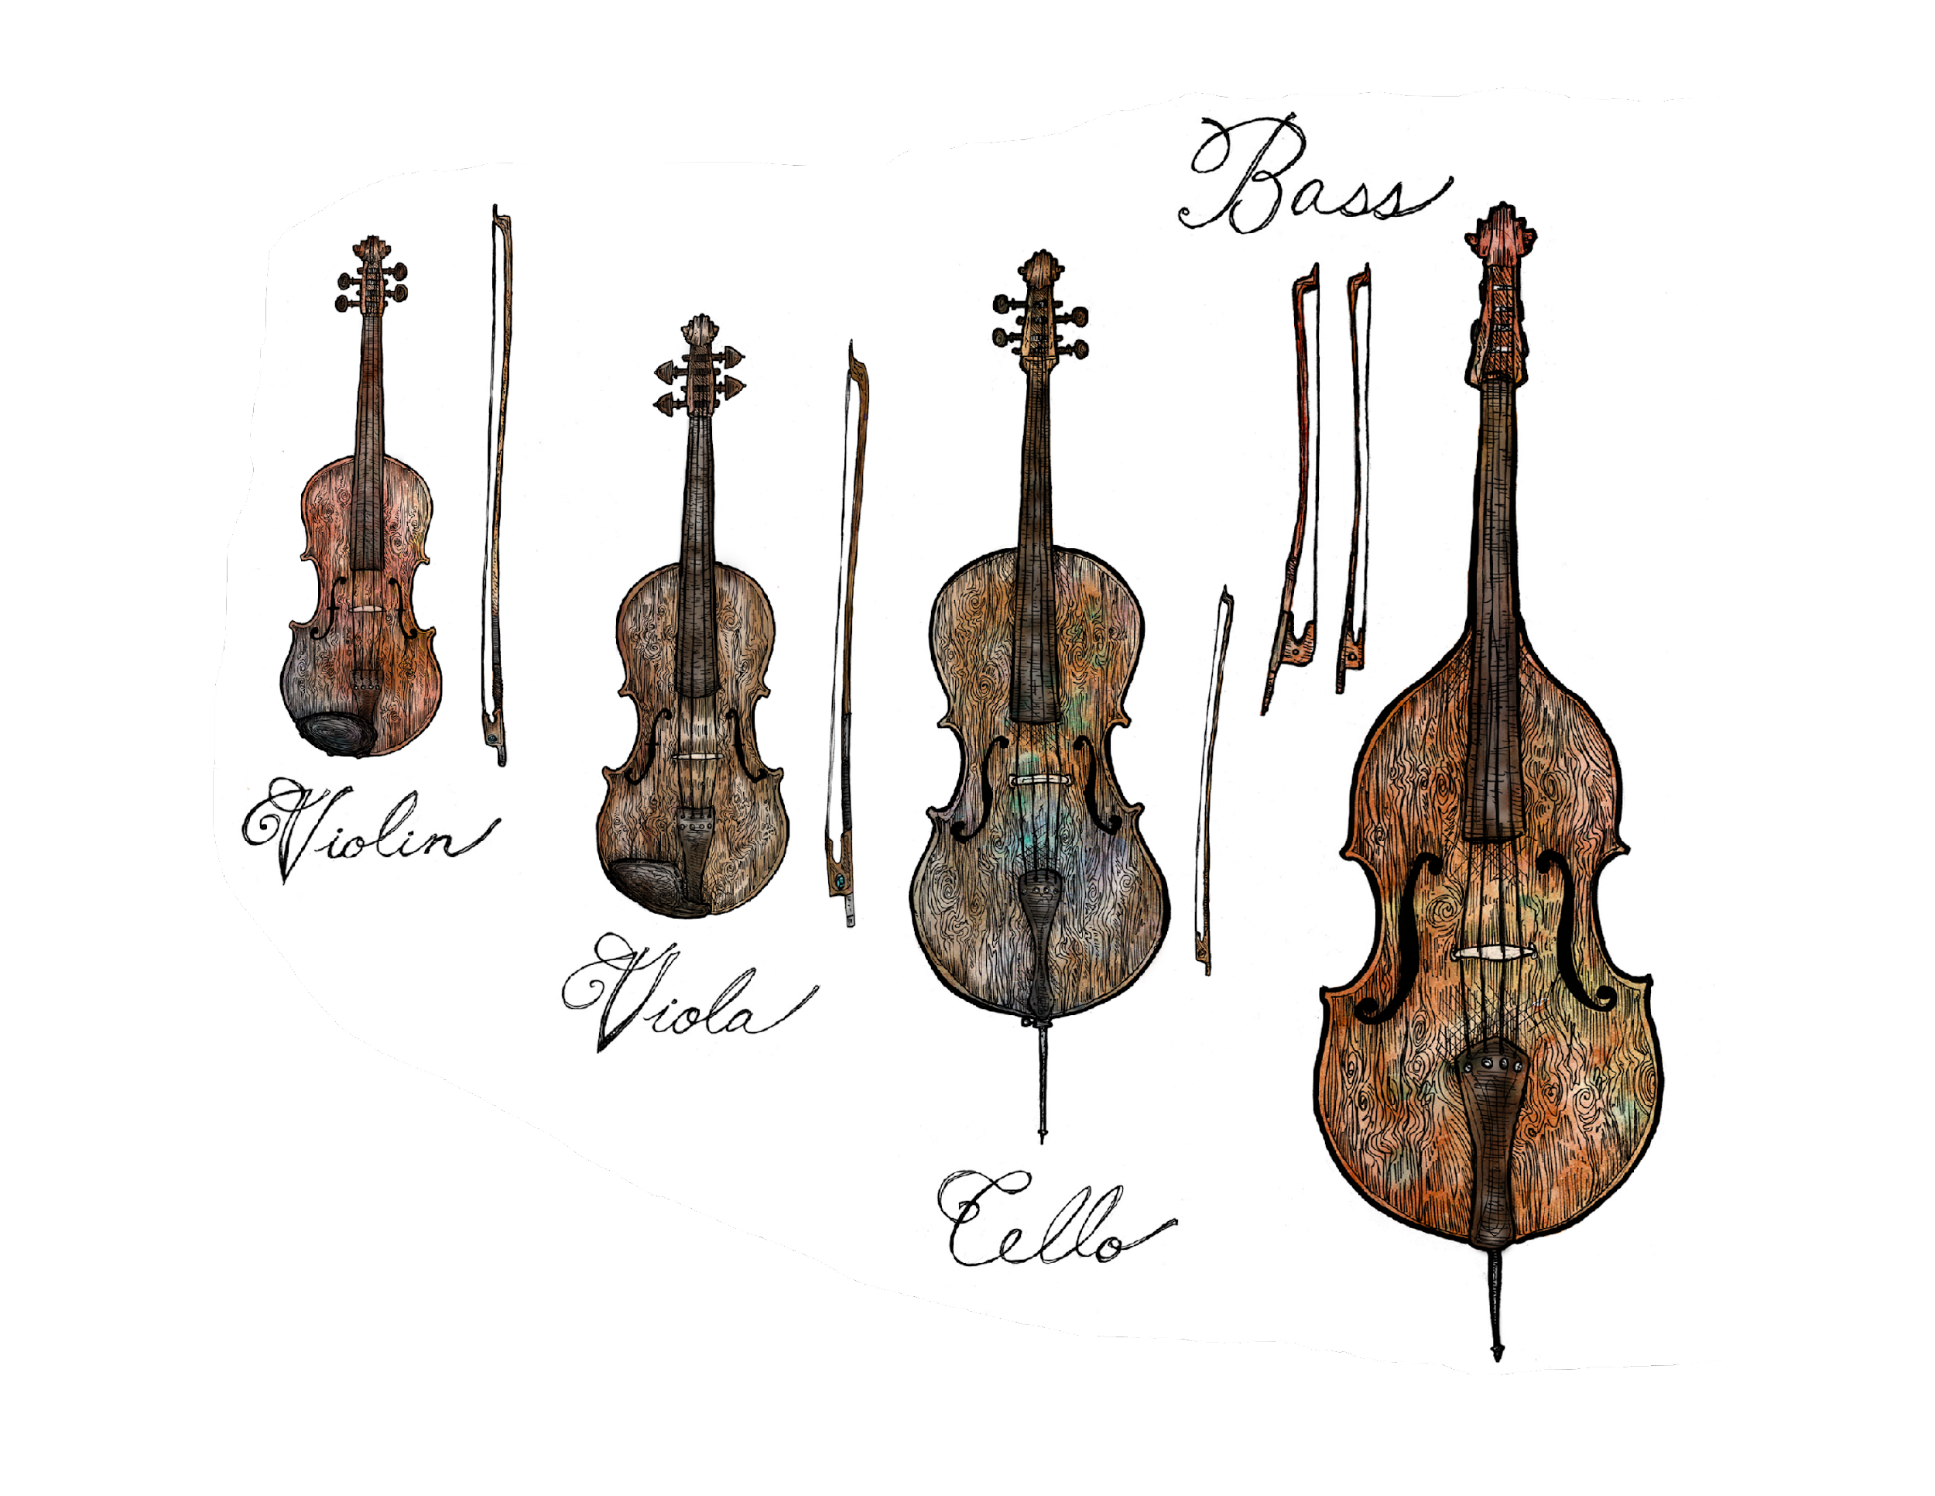
1.
2.
3.

Slide 24
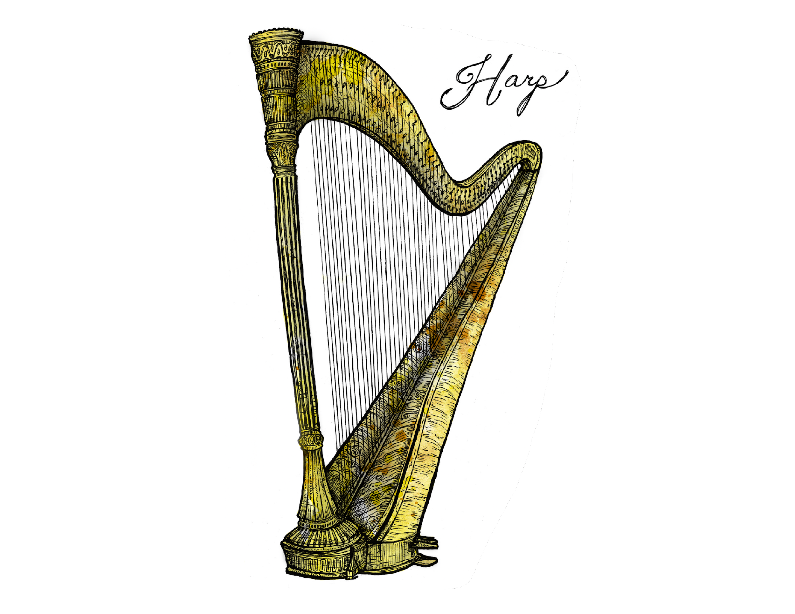
3.
1.
2.

Slide 25
Composer
What is a composer?
What does a composer do?

Slide 28
You Try It!
Topic/Story
Feeling
Song Title
Start Writing!

Slide 29
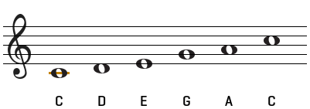
You Try It!

Slide 30
Lesson 3, Activity 1
Concert Etiquette
What is Etiquette? What does it mean?

Slide 31
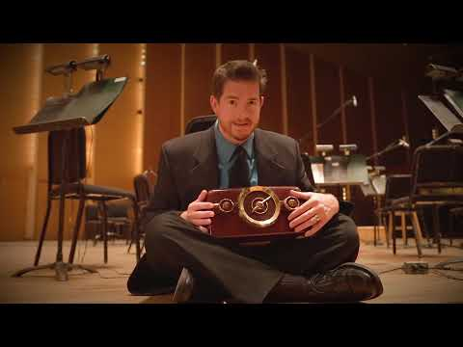
ETIQUETTE: the rules indicating the proper and polite way to behave
Write down 5 etiquette rules that might apply to an orchestra concert

